Slide 1
GlyStruct

Slide 2

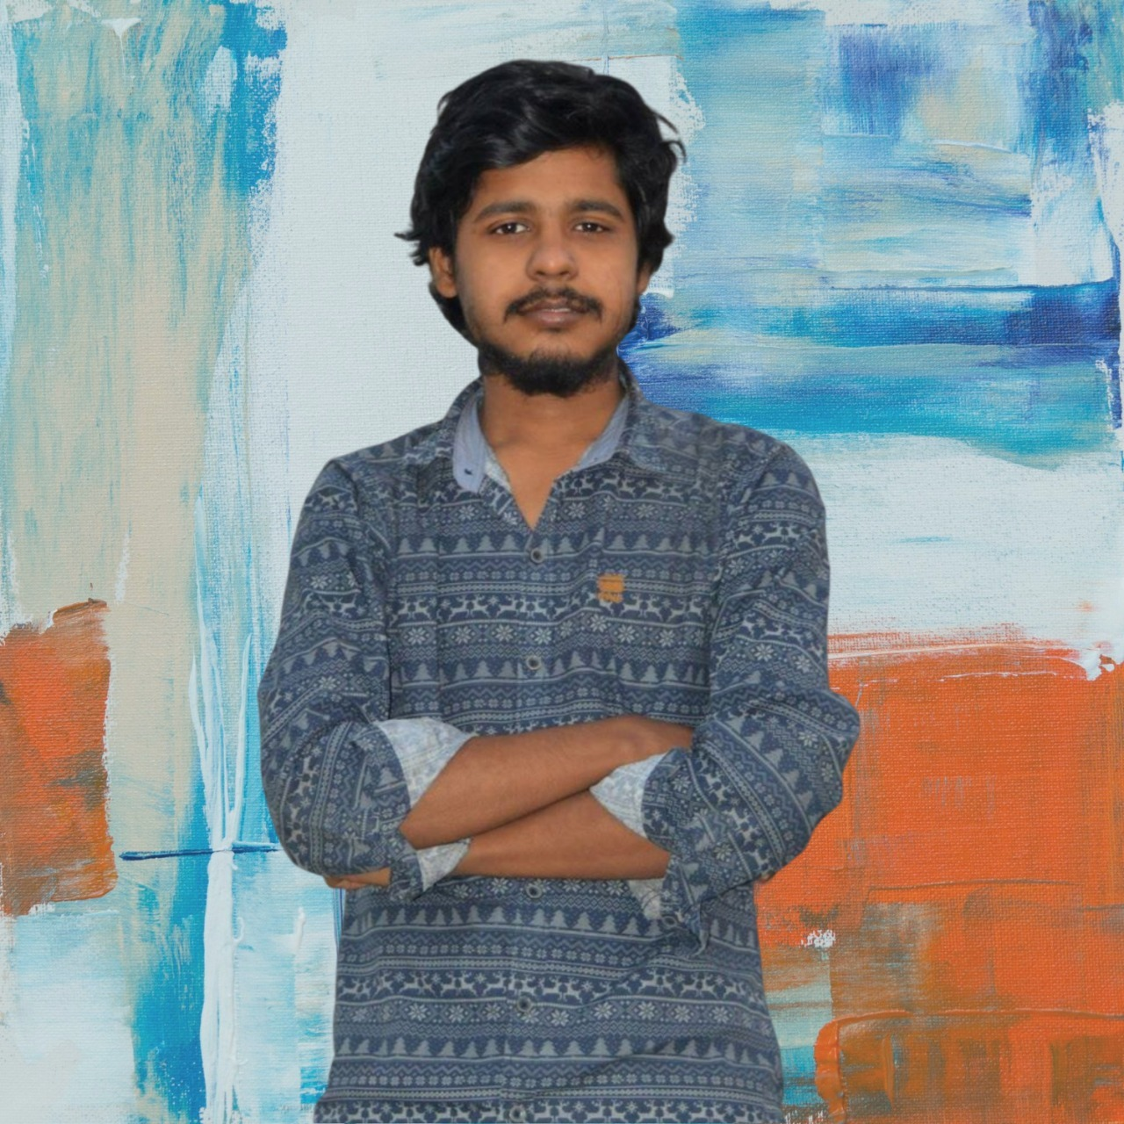


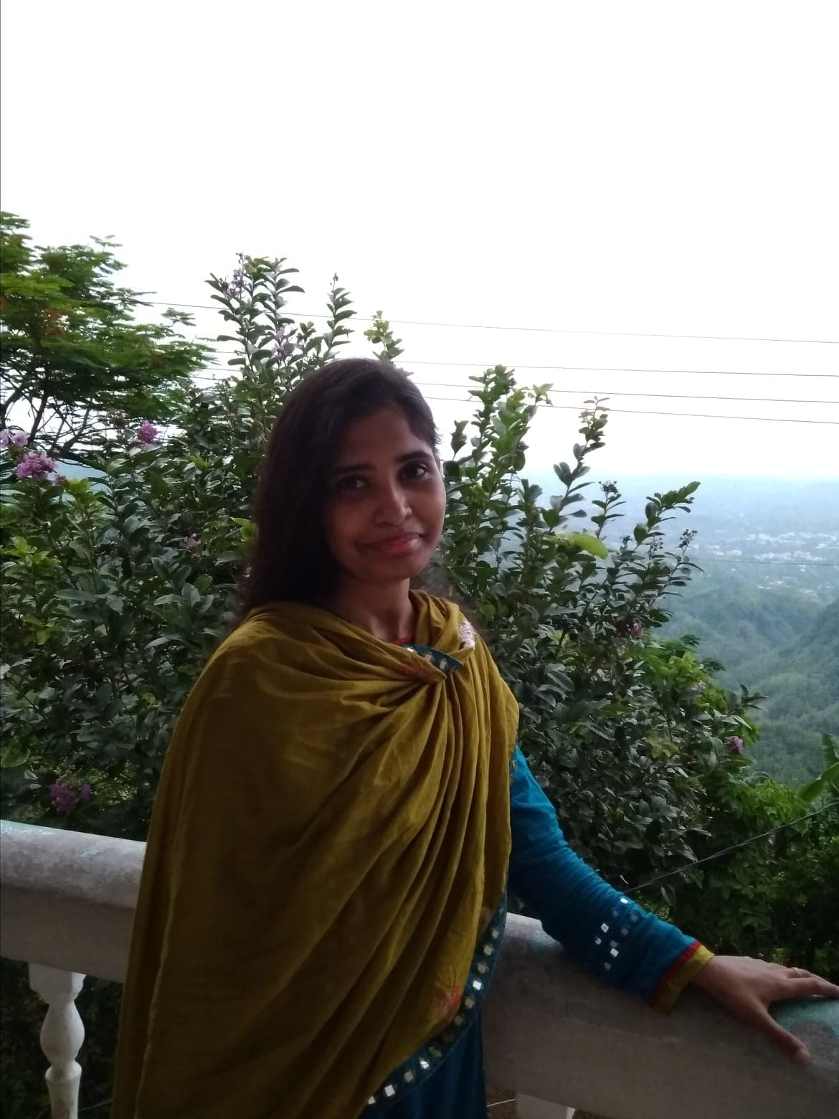

Turna Nishita Khan
Nasif Ishtiaque
Maria Mimi
Mehei Hasan
Mushfika Iffat
Azizur Rahman

Slide 3
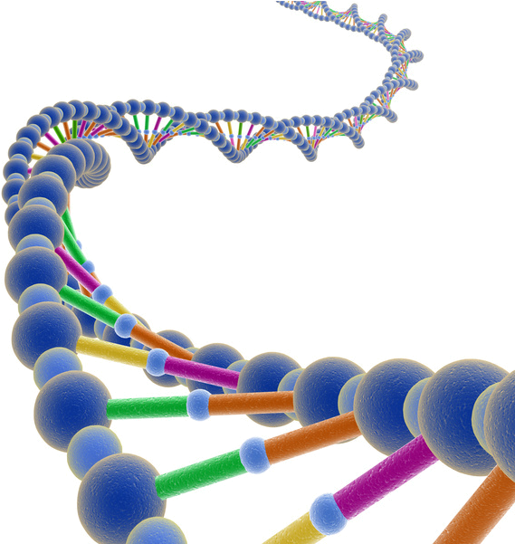




64
4
4
4
Codon

Slide 4
Several
Codons
20
Amino Acid
Several
Codons
Several
Codons

Slide 5
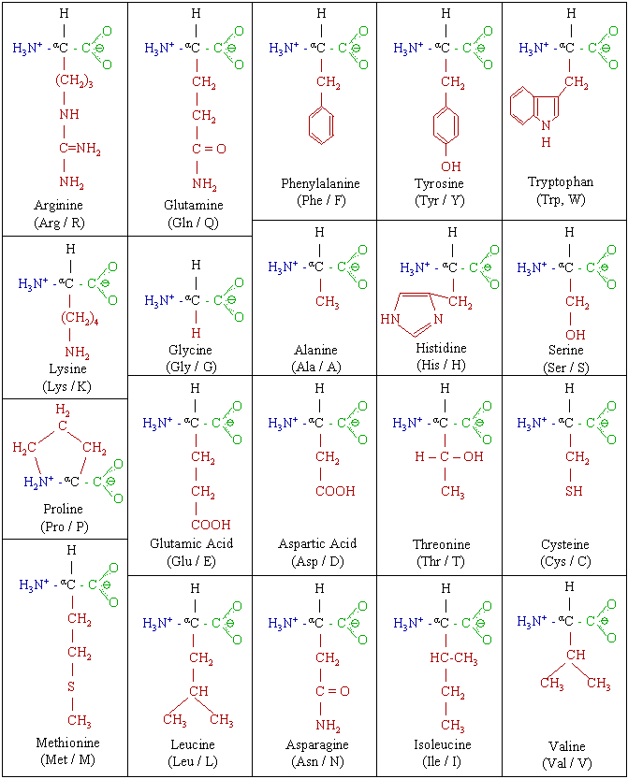
LYSINE

Slide 6
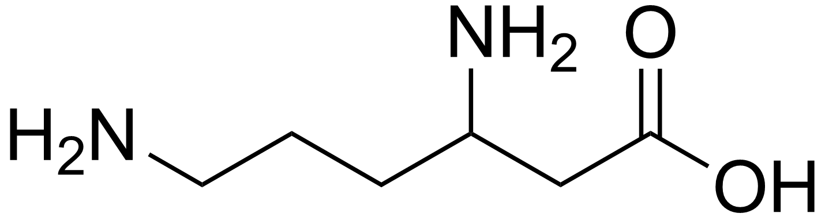
Post Translation Modification
Phosporus----
SUGAR----
Glycation
FAT----
Methyle----

Slide 7
Big concept
Motivation

Slide 8
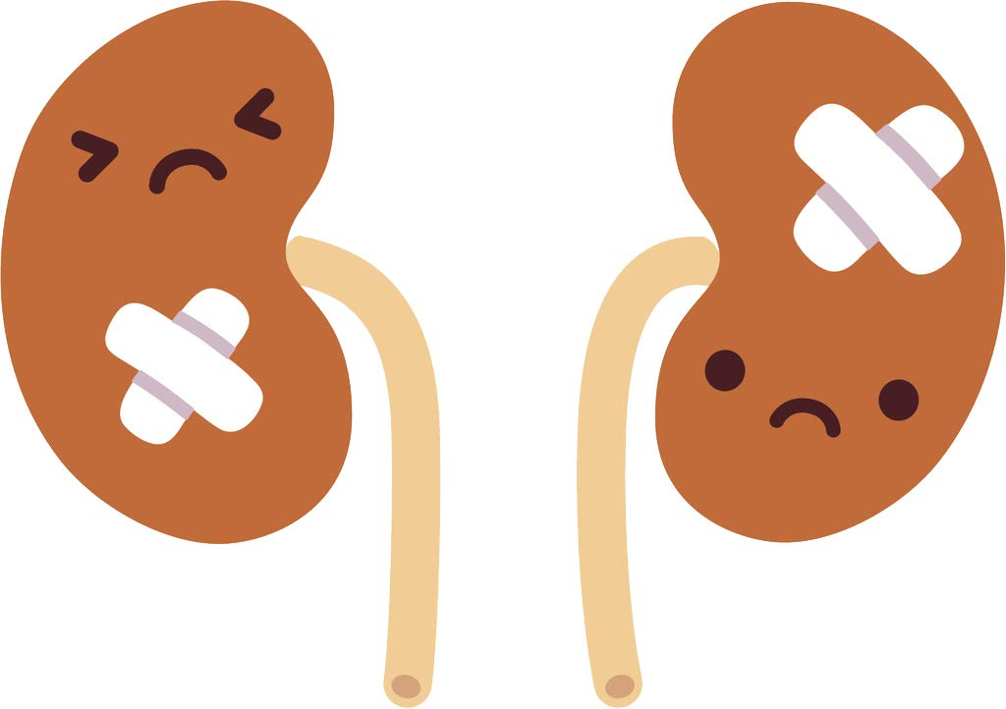



Health Issues
Affetcs protein, lipid, nucleic acid
Aging
Neurogenerative Disorders
Diabetes
Renal Failure
Immunological Changes
Progression of Tumors

Slide 9

Non Enzymatic
SUGAR----

Slide 10
GlyStruct
A Classifer
To detect glycated and non-glycated lysine
Better than existing classifiers

Slide 11
Overview
of the
Algorithm

Slide 12

DataSet Description
PLMB Database
6591 Lysine sites
857 Glycated
5734 Non-glycated

Slide 13
Feature Extraction
Gap
Dinucleotide
K-mer
4000
features
Data
Set
k = [ 1,10 ]

Slide 14
Feature Selection
Features
XGBoost
40% features

Slide 15
Algorithms
SVC
XGBoost
Logistic Regression
Random Forest
AdaBoost
K-nearest Neighbour
Decision Tree

Slide 16
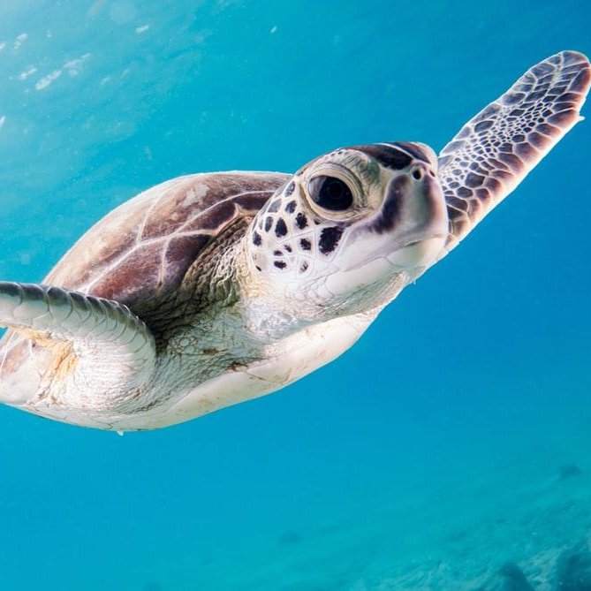
CODE

Slide 17

Results & Novel Work

Slide 18
Prediction
 | Accuracy | Sensitivity | Specificity | MCC | Precision
SVC | 90.04% | 31.83% | 100% | 0.53 | 100%
LR | 92.52% | 71.28% | 96.15% | 0.69 | 76.01%
KNN | 90.14% | 46.36% | 97.63% | 0.54 | 77.01%
DT | 91.66% | 74.39% | 94.61% | 0.67 | 70.26%
AdaBoost | 89.89% | 41.17% | 98.22% | 0.52 | 79.86%
RF | 95.75% | 71.28% | 99.94% | 0.82 | 99.51%
XGBoost | 92.11% | 46.02% | 100% | 0.64 | 100%

Slide 19
Result after 10 fold CV
 | Accuracy | Sensitivity | Specificity | MCC | Precision
SVC | 89.05% | 46.02% | 100% | 0.64 | 100%
LR | 93.66% | 46.02% | 100% | 0.64 | 100%
KNN | 91.26% | 46.02% | 100% | 0.64 | 100%
DT | 93.55% | 46.02% | 100% | 0.64 | 100%
AdaBoost | 91.15% | 46.02% | 100% | 0.64 | 100%
RF | 96.59% | 46.02% | 100% | 0.64 | 100%
XGBoost | 92.94% | 46.02% | 100% | 0.64 | 100%

Slide 20
Comparison
Method | Sensitivity | Specificity | Accuracy | MCC
GlyStruct [10 fold] | 0.7013 | 0.7989 | 0.7562 | 0.5065
GlyPseAAC [10 fold] | 0.6845 | 0.6745 | 0.6784 | 0.3587
GlyStruct [10 fold] | 46.02% | 100% | 96.59% | 0.64

Slide 21
Possible Improvement
Feature Extraction
Tertiary
CNN

Slide 22
Novel Work
SVC
Random Forest

Slide 23

Thanks!
Chowdhury Rafeed Rahman

